Slide 1
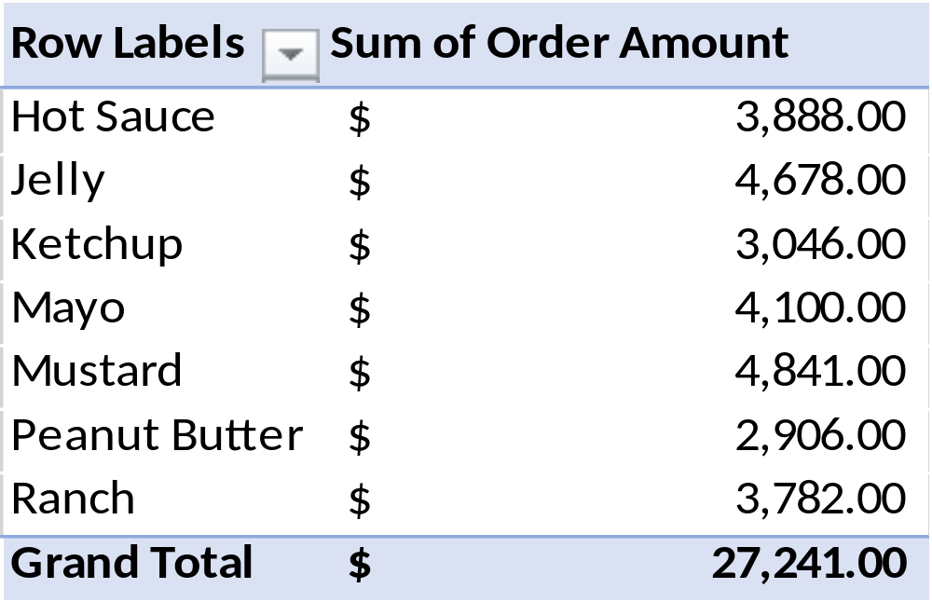
CONTROL PRICE OF NIGERIA

Slide 3
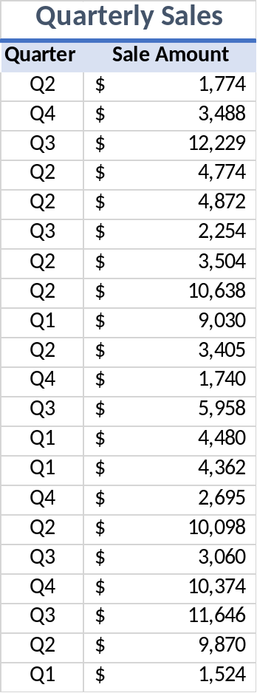
NEW SILDE

